Slide 1

Comprehensive Audit and Analysis for Effective Digital
Presence.
– Guttameedi Manasa

Slide 2
Company – ZOHO.
ZOHO is a leading provider of cloud-based business software solutions.
While its website effectively serves as a digital gateway to its offerings.
ZOHO take pride in creating products and solutions that help solve business problems, anticipate needs, and discover opportunities to help them grow.

Slide 3
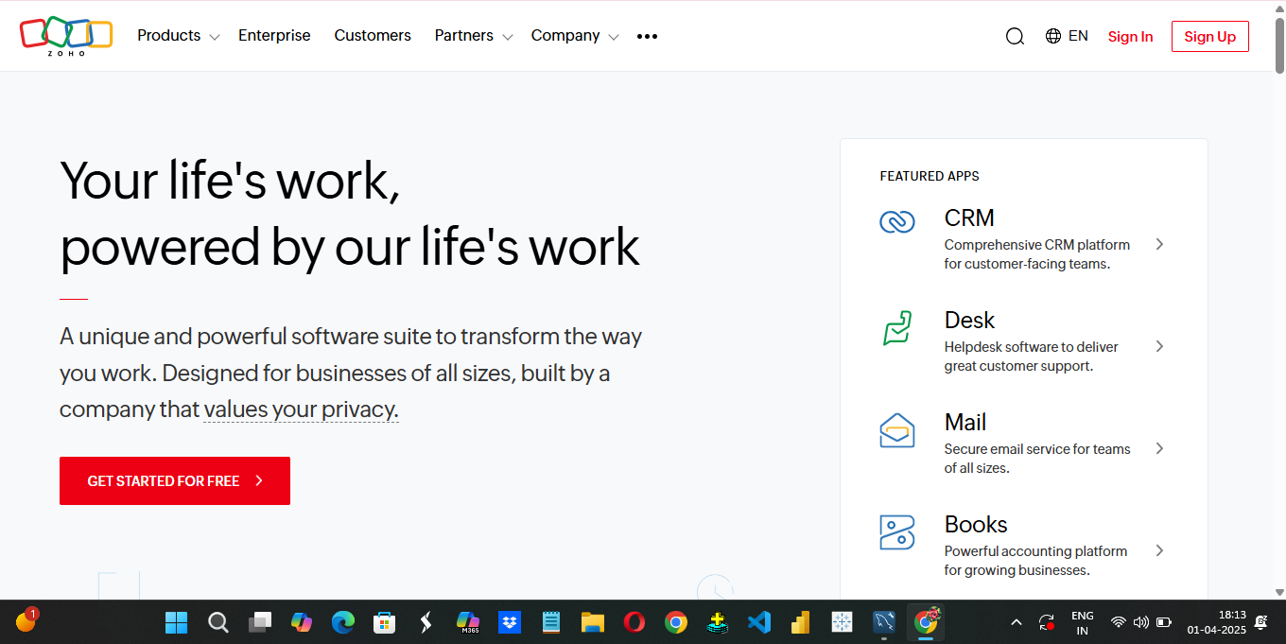

Slide 4
Website Audit report.
Design:
Content-Focused Approach.
Visual Hierarchy.
User Experience (UX):
Intuitive Navigation.
Mobile Responsiveness.
Performance Metrics.
SEO Metrics:
Organic Traffic.
Core Web Vitals.

Slide 5
Digital Marketing Strategy.
Recommendations | Traditional Marketing | Digital Marketing
Brand Awareness | TV, Print, Outdoor ads | Add brand story and recognition elements in website
Lead Generation | Use cold calls, direct mail, or trade shows to get contact info. | Integrate Traditional Channels into Your Landing Page

Slide 6
Relationship Building | Relationship marketing through field sales, loyalty programs, etc. | Personalized, Nurturing Content
Measuring ROI | ROI from TV, newspaper ads, or event participation is harder to track. | Use Analytics + Traditional Input
Educational Marketing | Use brochures, magazines, and events to inform customers. | Add Content That Supports Offline Goals.

Slide 7
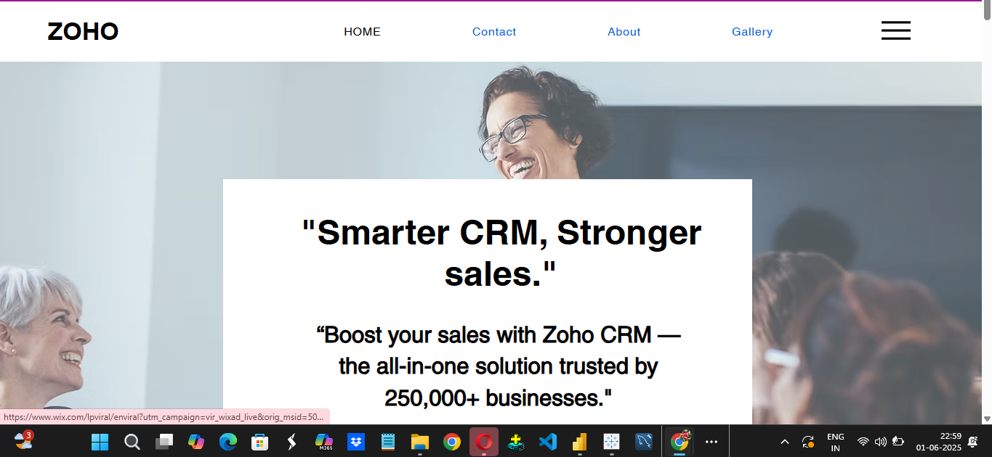
Website or Landing page Creation.
website link

Slide 8
THANK YOU.

